Slide 1
ANTI-SLEEP ALARM SYSTEM DURING DRIVING
Under guidance of
Dr. Shivanjali Khare
Assistant professor
Submitted by:
Deepak Mittapally
Ajay Kumar Vattam

Slide 2
Agenda
Introduction
Procedure
Implementation
Conclusion
References

Slide 3
Introduction According to the National Highway Traffic Safety Administration, sleepy driving causes almost 100,000 traffic collisions each year, resulting in more than 1,500 deaths and 70,000 injuries. The majority of sleepy driving incidents happen between the hours of midnight and 6 a.m., when drivers are alone in their vehicles.
Anti-sleep alarm system is the method to determine whether a given person’s eyes are closed and if the eyes have been closed for a certain amount of time, we’ll assume that he is starting to doze off and play an alarm to wake them up.
Detecting the face from the video stream and applying the facial landmark predictor to monitor the eyes is the main aspect of this system.

Slide 4
Objectives
The proposal is to determine whether the person in front of the web camera is active or sleepy.
This system is mainly used to detect the drowsiness of a driver to reduce the catastrophic accidents due his drowsiness with the help of an alarm. To develop a system that use eyes closure as a way to detect fatigue and drowsiness.

Slide 5
Approach
This project will be implemented in python. The Image is taken from the video through the front camera.
For the detection of facial landmarks the image is loaded in .dat file. EAR is calculated.(Eye Aspect Ratio)
The shape predictor will internally use SVM classifier based on HOG(Histogram of Oriented Gradients)

Slide 6
Procedure
STEP 1: We used dlib , imutils , numpy , scipy , cv2 packages
STEP 2: From imutils package , import VideoStream thread and instantiate the video stream using the webcam index of the laptop.
Start the video thread and loop over the frames from the video stream.

Slide 7
STEP 3 : Grab the frame from the video stream, resize it, and convert it into the gray scale. Detect the faces from the gray scale obtained using the dlib’s facial detector.
STEP 4 : Determine the facial landmarks for the face detected in Step 3 using the shape_predictor function of the dlib library.
STEP 5 : Convert the coordinates of the facial landmarks obtained to an numpy array using the shape_to_np function of the face_utlis module in the imutils package.

Slide 8
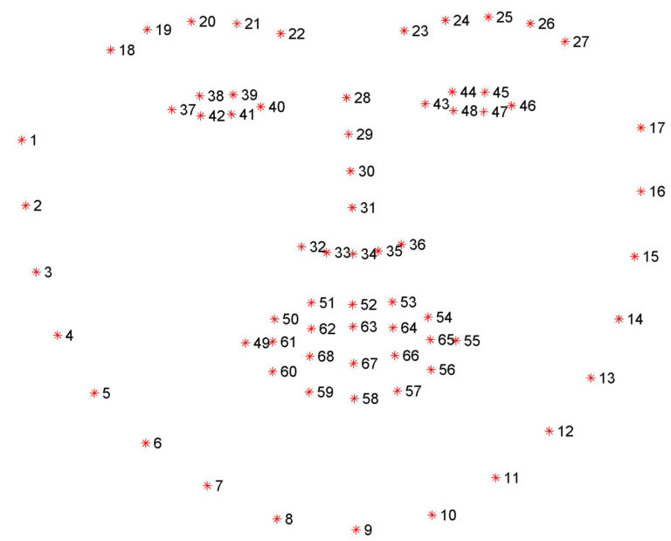
shape_predictor of dlib library
This function returns the 68-(x,y) coordinates that map to the facial structures of the face. We convert this into a numpy array

Slide 9
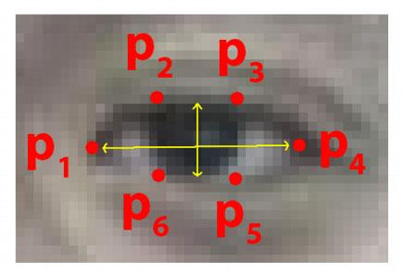
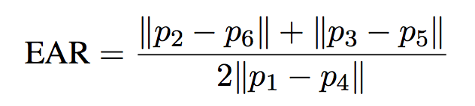
EAR ( Eye Aspect Ratio )
Here p1,p2,.......,p6 are the facial landmark positions of an eye. Each point represents a (x,y) coordinate.
EAR is given by the formula

Slide 10
STEP 6 : Extract the left and right eye co-ordinates from the numpy array and compute the EAR ( Eye Aspect Ratio ) for both the eyes and compute their average.
STEP 7 : Check to see if the EAR is less than the threshold declared( 0.25 ), if it is we need to increment the frame counter. If the frame counter increments the threshold frame value ( which is 48 frames ) then we sound an alarm.

Slide 11
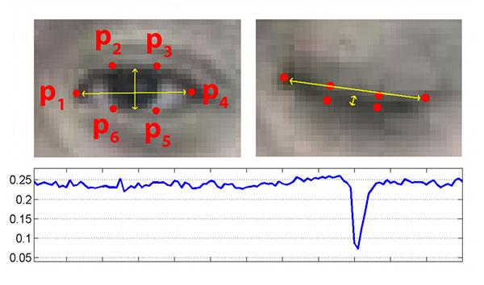
The EAR remains constant when the eyes are open and drops to zero when the person blinks
If we observe that the eye is remained close( EAR < threshold ) until the frame count increases beyond the defined frame count ( 48 ) then we sound an alarm

Slide 12
Flow Chart
Video stream from webcam
Detecting the face
Extracting the facial landmarks of the eye
Calculate EAR
else
Sound the alarm
Cons_frames >
threshold
EAR < threshold

Slide 13
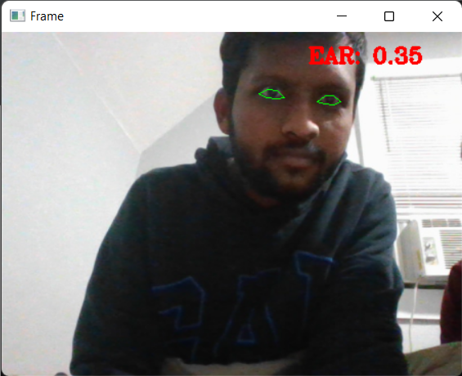
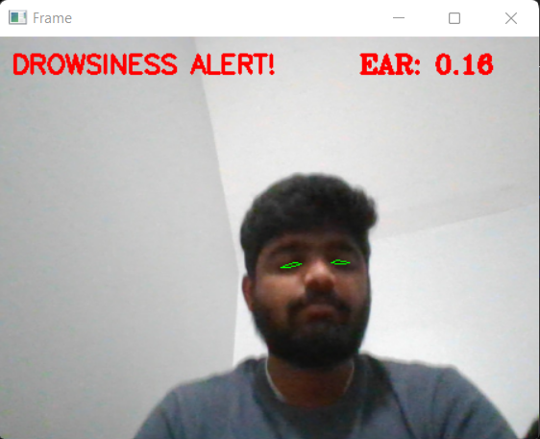

Slide 14
Conclusion
This project plays a key role in reducing the catastrophic accidents caused by the truck drivers due to their drowsiness by warning with the help of an alarm.
We can implement this idea in cars and trucks by which we can reduce the road accidents.

Slide 15
Limitations and future work
The video is not working for the person who uses spectacles and also in the low light areas. So, we have to use a better classifier which can detect the eye clearly.
This system can further be developed so that it can be implemented in other departments such as to detect employees who are sleeping in working hours.
We can also implement this concept in face time apps to detect the person is sleepy or not.
.

Slide 16
Deliverables:
A python file(.py) will be delivered at last.
Output will be an alarm sound when the person sleeps.
.DAT file and .wav will be delivered at the last.

Slide 17
References Facial landmark detection using dlib by Adrian Rosebrock Opencv tutorials with examples https://www.learnopencv.com/

Slide 18


